Slide 1

Session - 9

Slide 2
Content
Custom Renderer
Dependency Services

Slide 3
Custom Renderer
Xamarin.Forms user interfaces are rendered using the native controls of the target platform, allowing Xamarin.Forms applications to retain the appropriate look and feel for each platform. Custom Renderers let developers override this process to customize the appearance and behavior of Xamarin.Forms controls on each platform.
They can be used for small styling changes or sophisticated platform-specific layout and behavior customization.
Custom renderers for a given type can be added to one application project to customize the control in one place while allowing the default behavior on other platforms; or different custom renderers can be added to each application project to create a different look and feel on iOS, Android, and the Universal Windows Platform (UWP).

Slide 4
Creating Custom Renderer Class
The process for creating a custom renderer class is as follows:
Create a subclass of the renderer class that renders the native control.
Override the method that renders the native control and write logic to customize the control. Often, the OnElementChanged method is used to render the native control, which is called when the corresponding Xamarin.Forms control is created.
Add an ExportRenderer attribute to the custom renderer class to specify that it will be used to render the Xamarin.Forms control. This attribute is used to register the custom renderer with Xamarin.Forms.

Slide 5
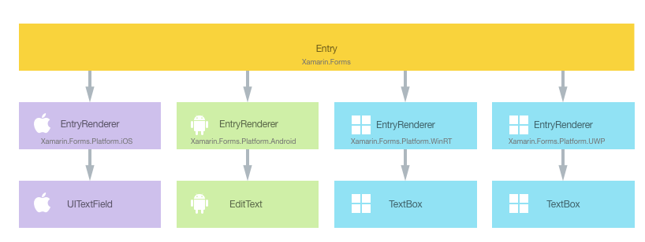
Customizing Entry
When an Entry control is rendered by a Xamarin.Forms application, in iOS the EntryRenderer class is instantiated, which in turns instantiates a native UITextField control. On the Android platform, the EntryRenderer class instantiates an EditText control. On the Universal Windows Platform (UWP), the EntryRenderer class instantiates a TextBox control

Slide 6

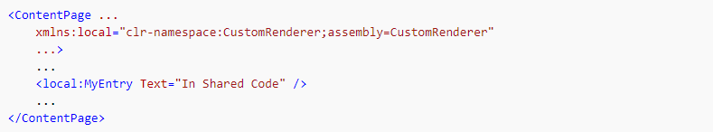
Creating Custom Entry Control
Consuming the custom Control

Slide 7
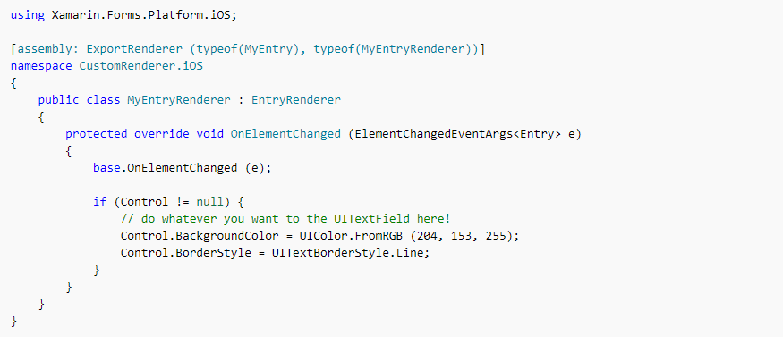
Creating Custom Renderer on each Platform
iOS

Slide 8
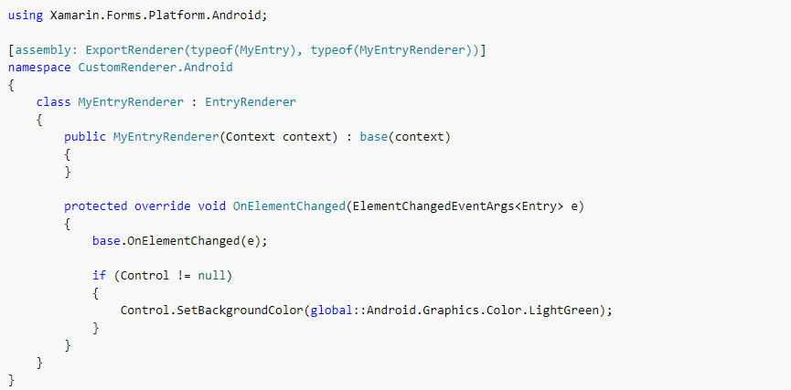
Android

Slide 9
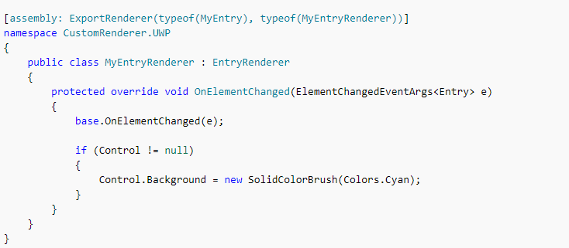
UWP

Slide 10
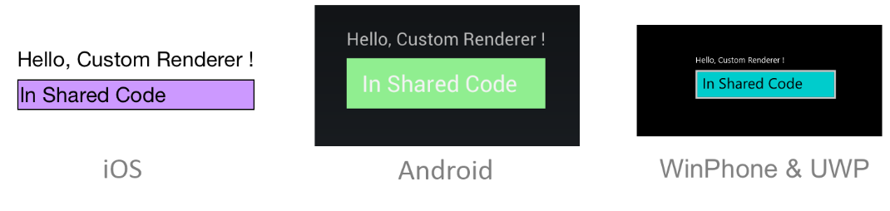
Screenshots of all three platforms

Slide 11
Dependency Services
Dependency Services allows apps to call into platform-specific functionality from shared code. This functionality enables Xamarin.Forms apps to do anything that a native app can do.
It is a dependency resolver. In practice, an interface is defined and DependencyService finds the correct implementation of that interface from the various platform projects.
Xamarin.Forms apps need three components to use DependencyService:
Interface – The required functionality is defined by an interface in shared code.
Implementation Per Platform – Classes that implement the interface must be added to each platform project.
Registration – Each implementing class must be registered with DependencyService via a metadata attribute. Registration enables DependencyService to find the implementing class and supply it in place of the interface at run time.
Call to DependencyService – Shared code needs to explicitly call DependencyService to ask for implementations of the interface.

Slide 12
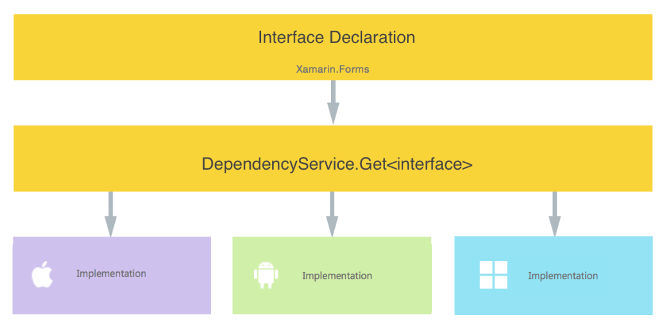
Structure

Slide 13
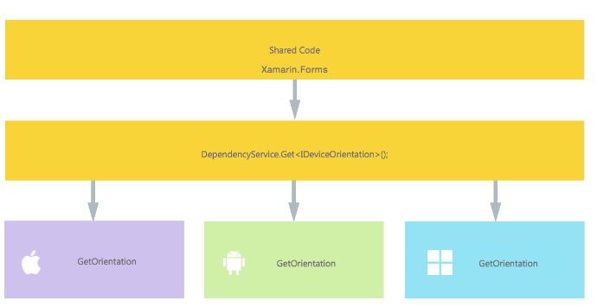
Checking Device Orientation
The interface that is designed, will define how you interact with platform-specific functionality.

Slide 14
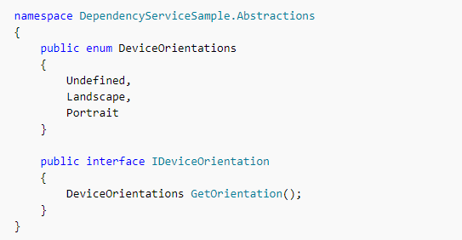
Creating Interface
Coding against this interface in the shared code will allow the Xamarin.Forms app to access the device orientation APIs on each platform.

Slide 15
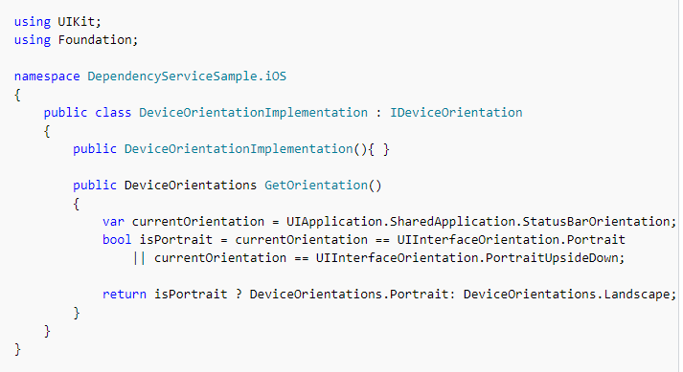
iOS Implementation

Slide 16
Registration
This attribute registers the class as an implementation of the Interface, which means that DependencyService.Get<Interface> can be used in the shared code to create an instance of it.

Slide 17
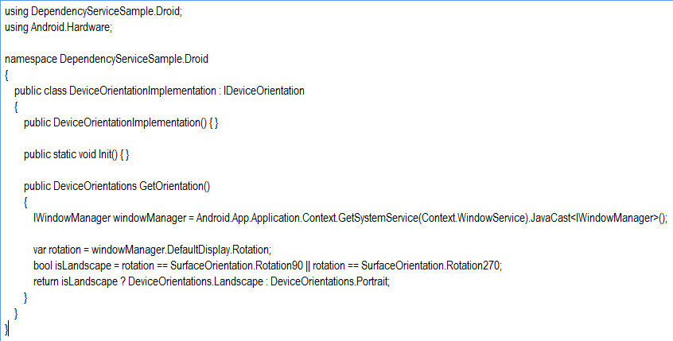
Android Implementation

Slide 18
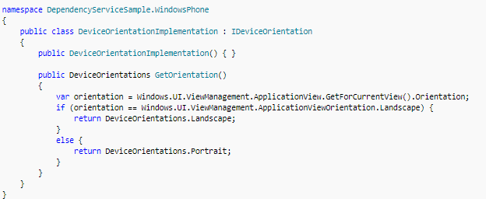
UWP Implementation

Slide 19
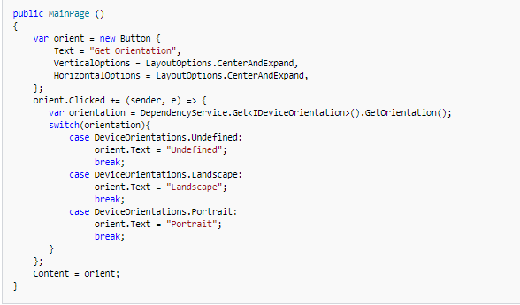
Implementing in shared code

Slide 20
